Slide 1


Department of Computer Science and Engineering
Predictive Blood Donation Scheduling and Real-Time Stock Monitoring using XG Boost
Dr. M. Rakesh Kumar, M.E., Ph.d., Assistant Professor
Roll no : 2116220701261
Name : Shanmuga Divya K

Slide 2
Problem Statement and Motivation
Healthcare systems face unpredictable blood demand and limited donor turnout.
Manual tracking causes inefficiencies.
A machine learning solution like XGBoost can predict trends, optimize donation scheduling, and ensure better stock monitoring.

Slide 3
Existing System
Manual or fixed-interval reminders are used for donation scheduling.
Demand forecasting is limited.
Some ML models exist but lack real-time integration and adaptability.

Slide 4
Objectives
Forecast blood demand using historical and demographic data Real-time stock monitoring with alerts Optimize donor engagement and minimize blood wastage

Slide 5
Abstract
XGBoost-based framework predicts blood demand and monitors inventory in real-time. It uses donation history, transfusion data, and seasonal trends to provide accurate scheduling. Results show up to 20% reduction in wastage and better donor turnout.

Slide 6
Proposed System
Dual-module system using XGBoost for blood donation scheduling and stock monitoring.
Historical and real-time data are processed, normalized, and used for classification and regression models.

Slide 7
System Architecture
Four-layered architecture:
Data Acquisition, Processing, Modeling, and Output. Handles data ingestion, preprocessing, XGBoost prediction, and user feedback.

Slide 8
List of Modules
User Interface
Data Collection and Preprocessing XGBoost Prediction Model Deployment
Result Analysis

Slide 9
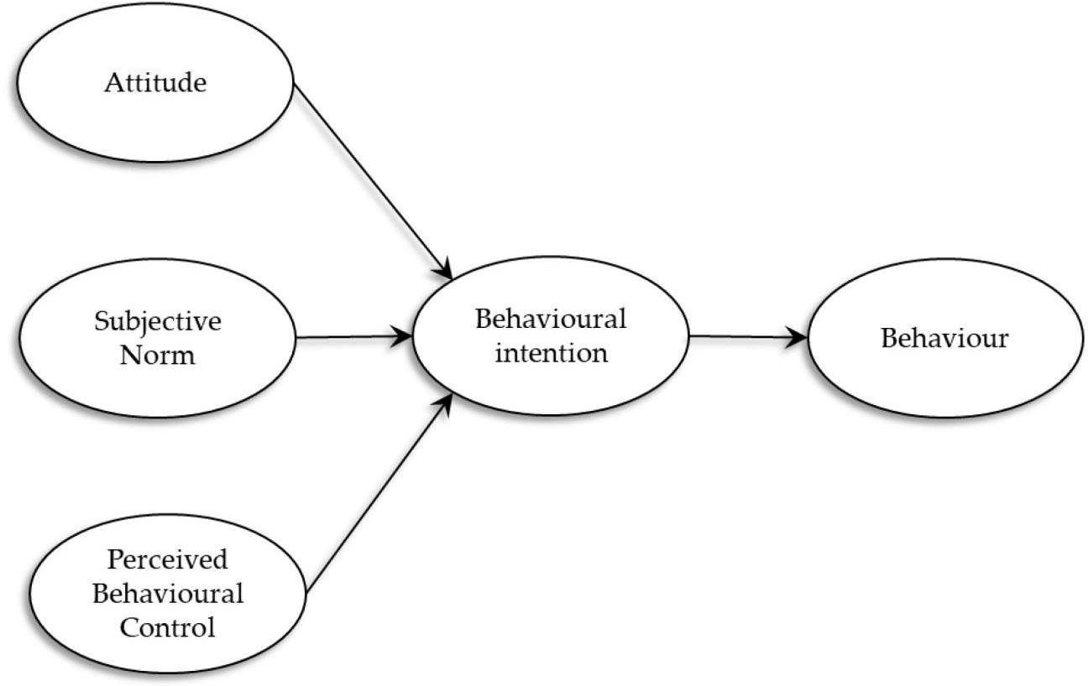
Functional Description for each modules with DFD and Activity Diagram
At the first level, two main external entities donors and stock market APIs-interact with the system. Donor data, including personal and medical information, is input into the Donor Management System, while stock price data, volume, and market indicators are fetched in real time from APls like Yahoo Finance or Alpha Vantage and sent to the Market Data Module.
Fig: Data Flow Diagram

Slide 10
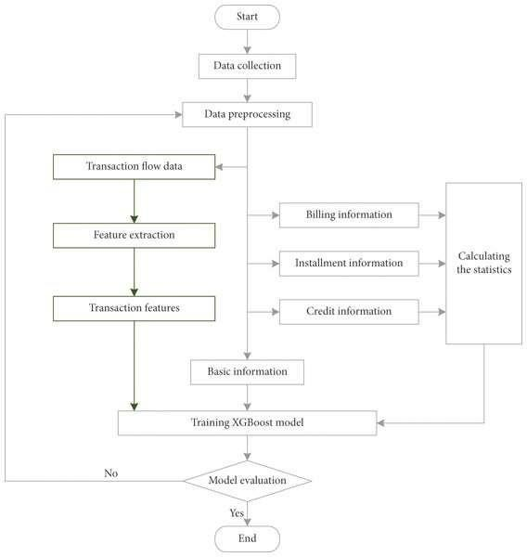
The system collects donor and stock data, preprocesses it by cleaning and feature engineering, then trains two XGBoost models—one for predicting blood donation schedules and another for stock trends. Finally, it generates real-time predictions to improve donor engagement and stock analysis, ensuring timely actions and efficient resource management.
Fig: Activity Diagram

Slide 11
Implementation & Results of Module
Implemented using Flask backend and React frontend. Integrated APIs and real-time prediction system.
Outputs include donor schedules, stock alerts, and prediction graphs.

Slide 12
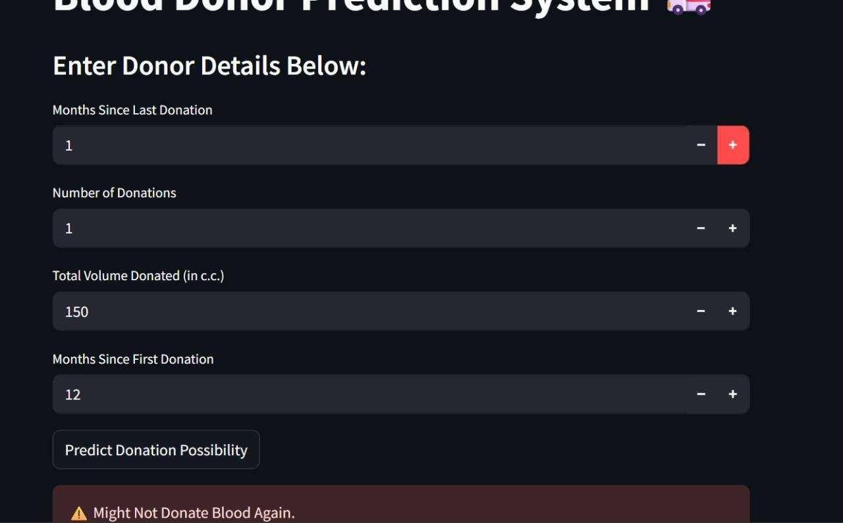
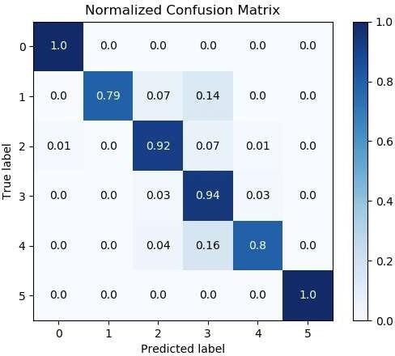
Results

Slide 13
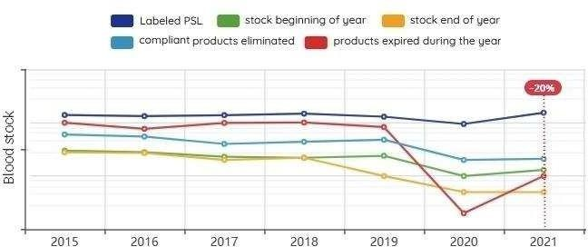
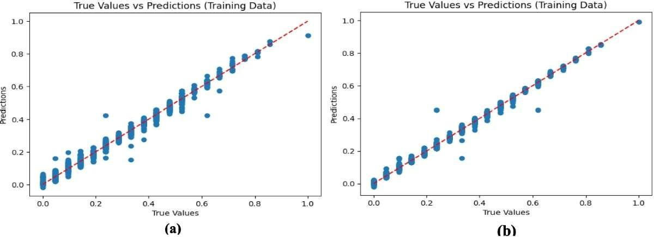

Slide 14
Conclusion & Future Work
System improves scheduling accuracy and inventory management.
Future work includes adding deep learning models, real-time hospital integration, and a mobile app.

Slide 15
References
[1] Chen, T., & Guestrin, C. (2016) XGBoost A scalable tree boosting system. In Proceedings of the 22nd ACM SIGKDD International Conference on Knowledge Discovery and Data Mining
[2] UCI Machine Learning Repository Blood Transfusion Service Center Data set from, https://archive.ics.uci.edu/ml/datasets/blood+transfusion+service center
[3] Aggarwal, R., & Singh, A. (2020). Data preprocessing techniques in machine learning. International Journal of Computer Applications, 975, 8887.

Slide 16
Thank You

